Slide 1

Assignment 5: Earthquake Data Visualisation
Irina Danila

Slide 2
Earthquake data
- Time-wise, covers last month: 26/12/23 to 25/1/24
- Data visualisation
- Source: The ANSS Comprehensive Earthquake Catalog (ComCat) contains earthquake source parameters (e.g. hypocenters, magnitudes, phase picks and amplitudes) and other products (e.g. moment tensor solutions, macroseismic information, tectonic summaries, maps) produced by contributing seismic networks.
- Many of the columns relate to error measurement of stations and apparatus

Slide 3
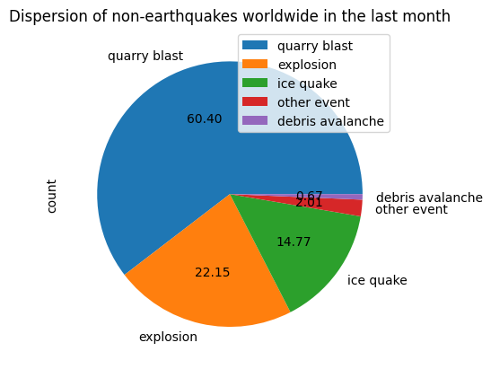
Non-earthquake events of high enough magnitude to be recorded
- 149 events were non-earthquakes
- constitute 1.6% of total events
- In amongst these, quarry blasts were highest in number at 90 (60%)
- Pie chart showing percentage of non-earthquake events within the data set

Slide 4
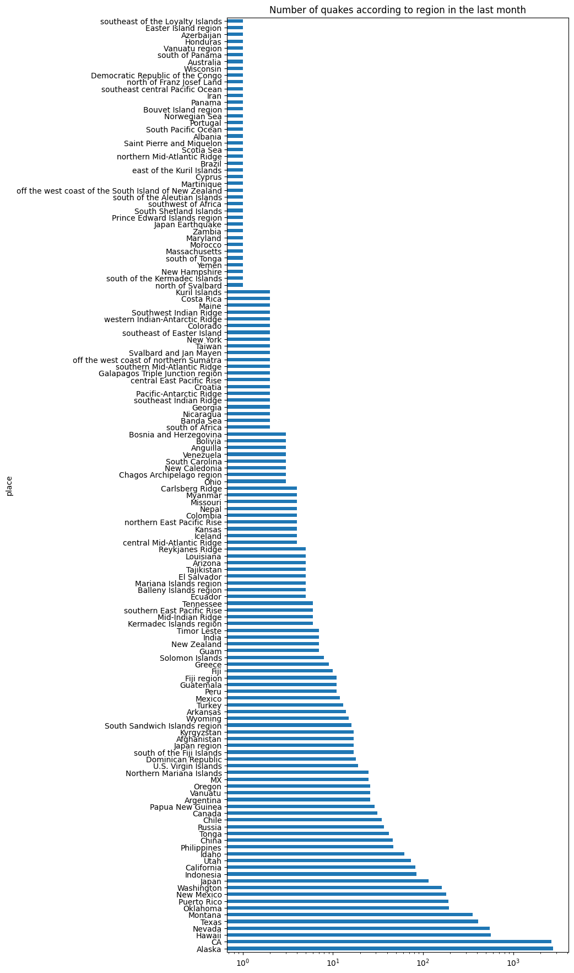
Number of events per region within the last month
- x axis shows log scale of number whereas the y scale shows where the events happened
- shows variation in number of events is significant – some places had 1 event, others had >1k; however, this may be due to country/state naming conventions and the difficulty in defining them
- further investigation could elucidate whether certain areas have consistently more seismic activity than others

Slide 5
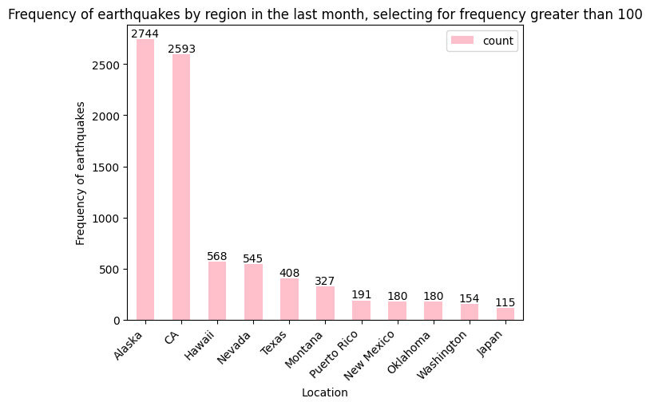
Top 11 countries with earthquake activity in the last month
- Top 11 locations include Alaska, California, Hawaii, Nevada, Texas, Montana, Puerto Rico, New Mexico, Oklahoma, Washington and Japan
- Most based in N. America – is this due to the data set being connected to American networks (American website) or is this a true reading of earthquakes worldwide?
- could be interesting to compare the sizes of the countries/state

Slide 6
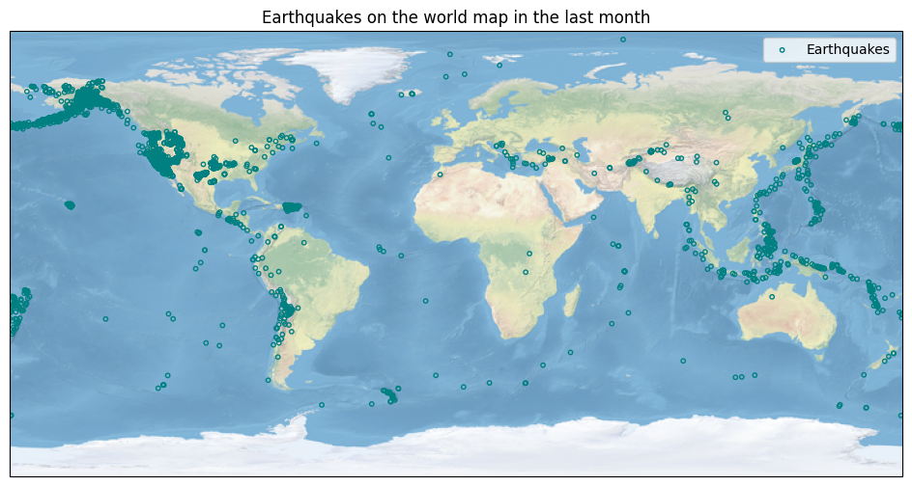
Earthquakes on the world map in the last month
- Can see localisation of earthquakes on the world map
- Certain areas have higher densities – North, Central and South America, Japan, Philippines, Indonesia, Pacific Ocean
- would be interesting to plot a heat map to asses density rather than a scatter plot

